Slide 1
God Mends Us
and Sends Us
John 9:1-12
Notes:
INTRO: Pastor Vince has been featuring the parables of Jesus this summer. Pearl of Great Price, Prodigal Son, Mustard Seed and others, which have all pointed to what the Kingdom of Heaven is like.

Slide 2
par·a·ble
noun
a simple story used to illustrate a moral or spiritual lesson
ob·ject les·son
noun
an example from real life that
teaches a lesson or explains something
Notes:
PARABLE A simple story used to illustrate a moral or spiritual lesson or concept.

Slide 3
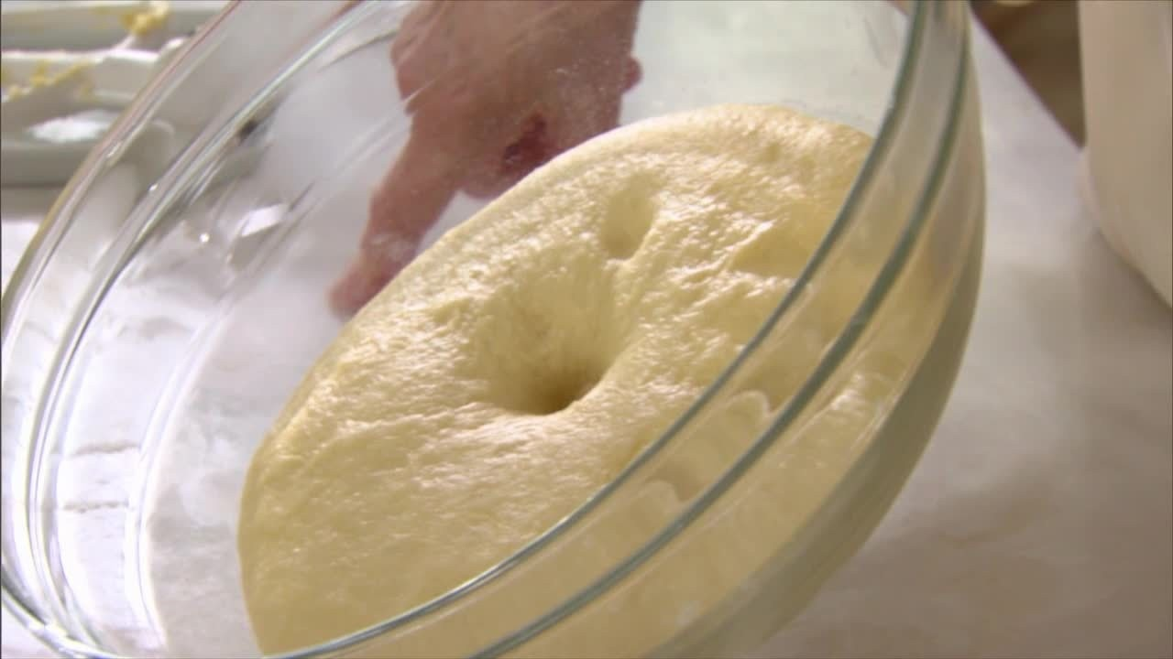
The Kingdom of God is like Yeast
Notes:
Last week we looked at how the Kingdom of Heaven is like Yeast. Just as Yeast infuses, penetrates, infiltrates bread dough – so the Kingdom of Heaven infiltrates our world, bringing light and life and blessing.
Today’s Story features a real story. But it’s function is the same. It teaches us a lesson about the kingdom of God.
This Story is going to build off of last week by helping us understand the nature of what happens when the kingdom of heaven becomes like yeast, infusing and infiltrating the world. It will show us what Jesus’ ministry looked like as He brought the kingdom of heaven to our world here on earth.

Slide 4
The Father Sent Jesus
“The Spirit of the Lord is on me, because he has anointed me to proclaim good news to the poor. He has sent me to proclaim freedom for the prisoners and recovery of sight for the blind, to set the oppressed free.” Luke 4:16
Notes:
Jesus described His ministry by quoting a Scripture from Isaiah, “The Spirit of the Lord is upon me, for He has anointed me to proclaim good news to the poor. He has sent me to proclaim freedom for the prisoners and recovery of sight for the blind, to set the oppressed free.” Luke 4:16
This story illustrates this ministry, this calling of Jesus.
This story ALSO tells us how to we are part of bringing the kingdom of heaven to our broken world.

Slide 5
Today’s Text – John 9:1-12
“As He along, He saw a man blind from birth.
His disciples asked Him,
“Rabbi, who sinned, this man or his parents, that he was born blind?”
‘Neither this man nor his parents sinned,’ said Jesus,
‘but this happened so that the works of God might be displayed in him.
Went
Notes:
As we read John 9:1-12 together – be looking for a recurring theme. We tend to gloss right over things sometimes, so I decided to add a little emphasis to certain words. See if you can pick up on anything ☺

Slide 6
As long as it is day,
we must do the works of Him who Me.
Night is coming when no one can work.
While I am in the world I am the light of the world.’
After saying this, He on the ground,
made some mud with the saliva, and put it on the man’s eyes.
SENT
SPIT

Slide 7
he told him,
wash in the Pool of Siloam (this word means ).
So the man and washed, and came home seeing.
His neighbors and those who had formerly seen him begging asked,
‘Isn’t this the same man who used to sit and beg?’
GO
SENT
WENT

Slide 8
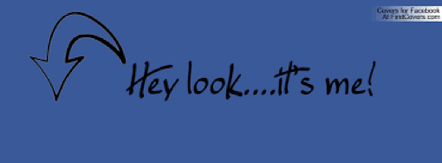
Some claimed that he was, others said, ‘No, he only looks like him.’ But he, himself, insisted, ‘I am the man!’

Slide 9
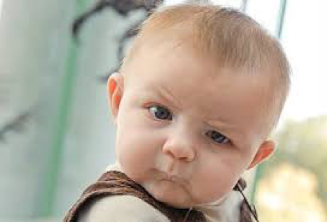
‘How then were your eyes opened?’ they asked.

Slide 10
He replied,
‘The man they call Jesus made some mud and put it on my eyes.

Slide 11
‘He told me to to Siloam (remember this means ) and wash.
So I and I washed, and then I could see.’
GO
(SENT)
WENT

Slide 12
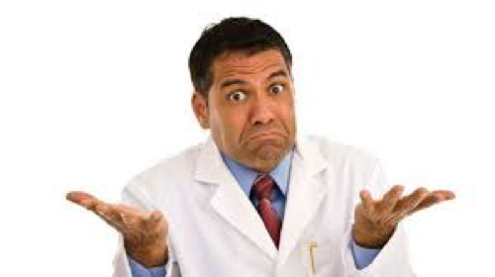
Where is the man?’ they asked him.
‘I don’t know,’ he said.”

Slide 13
We Have Been
SENT
To Display the Works of God
Notes:
Were you able to pick up on anything? I hope you were able to se that The man was SENT and he WENT. I hope you were able to see that Jesus Himself was SENT by the Father. The Father SENT and Jesus WENT.

Slide 14
Jesus Included His Disciples
Notes:
Jesus includes His disciples in this mission of being SENT. Did you catch it? He said – We must do the works of Him who sent Me.
The Father sent Jesus, but the disciples are part of this ‘sending.’ So are we. This is that picture of the yeast that permeates and infiltrates the world with the gospel.

Slide 15
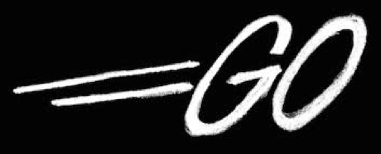
Jesus the Blind Man
Sent
Notes:
And Jesus tells the man to “GO.” Not only to Go, but to go to the place of being Sent. The pool of Siloam. While he is still in the dark.

Slide 16
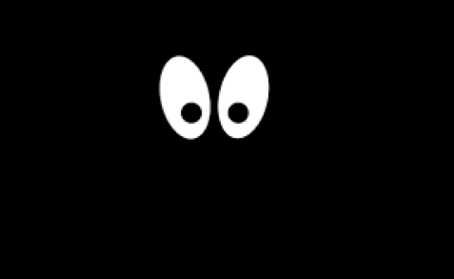
Notes:
He has mud and spit all over his face, covering his eyes. And Jesus tells him to “Go.” We’re gonna get back to that.

Slide 17
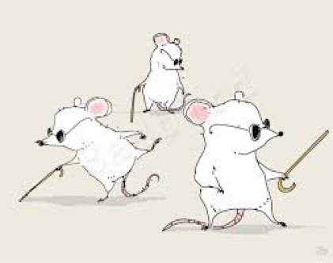
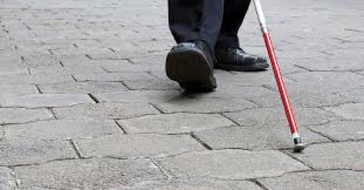
We are the blind man
we all have areas of need
Notes:
First, it’s important for us to understand that we ARE the blind man from the story. We all are part of this broken world and we all have had some area that we’ve needed God to touch and to heal … an area where we’ve needed to be made whole, to be restored and delivered.
And just like the blind man in the story, Jesus works in our lives and sends us – even while we’re still in the dark.

Slide 18
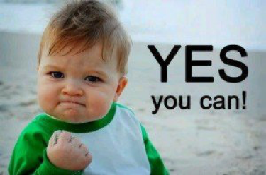
We Can Do This!
Notes:
And you know what? We can do this! By God’s grace and mercy and in His power and forgiveness, trusting in the One who has touched us and called us … we can ‘GO’
Question: Could it be that the very areas of our brokenness, of our weakness, of our places of need, … are the very areas that God will use to display His works of glory? Jesus told His disciples that this man was born blind in order to display the works of God.

Slide 19
God Mends Us
Could it be that the very areas of our brokenness, of our weakness, of our places of need, can serve as the means by which God displays His glory?
Notes:
But what does that look like, for ….Me, you, our congregation?
What did it look like for Jesus?

Slide 20
Notes:
Jesus, the Eternal One, the Alpha and Omega, the Beginning and the End. The One who exists outside of time, the One who created time is also the Great I AM.
The passage begins with a tiny word that begins this entire story. “AS”
AS He went along … in the middle of going. He is in the moment. “AS”
You know we can discipline ourselves to Be in the moment? To take note of what is with us right now. Our breathing, the tension in our neck or our jaw? … the rustle of the leaves in the wind with the smell of grass …
“As” Jesus was in the moment …

Slide 21
Notes:
He saw – He attended to… He took note of …. He paid attention to - In our world of being inundated with data and information and images and messages, it’s hard to attend to everything. In fact it’s impossible to take it all in. Our brain begins shutting things out as ‘noise.’ We have to. But Jesus was in tune with His Father, and so He was prompted by the Father to SEE. We can also be in tune with the Father, through the Holy Spirit, to SEE.
And what did Jesus see?

Slide 22
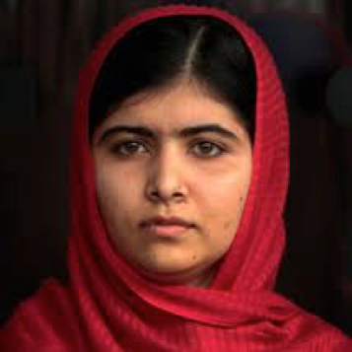
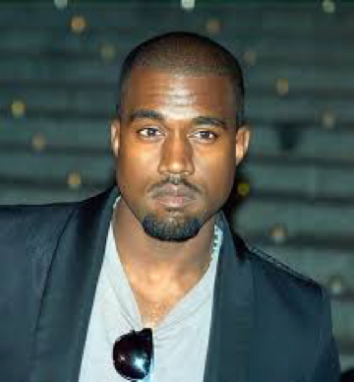
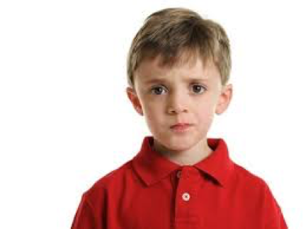
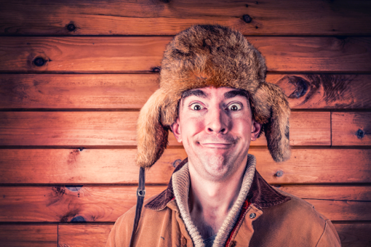
Jesus Saw ….. A Person
Notes:
A MAN. A PERSON with a need.
He didn’t see a nuisance, a problem, a lesser being, a sinner.
No … He saw a person. A person with a need.
The disciples didn’t notice the person, so much as they did the problem – the sinner. In order for the kingdom of God to infiltrate, influence, impact the world through us – we need to see the people. In the moment, each moment we need to see the ‘people’ God puts in our path – not the drug addict, not the homeless person, not the Muslim, not the Hispanics or the Whites or the political party or…. __________ fill in the blank. See people for people. See them as God’s opportunity to display His Works, to glorify the Father.

Slide 23
Jesus Healed the Blind Man
as the Man Went
Do what God says to do - while you’re still in the dark!
We won’t always “see” before we’re called to “do.”
Notes:
Going while we’re still in the dark is sometimes part of the process. We don’t have everything all together yet, but we go, by the direction of the Holy Spirit, we go and trust that he is at work in us and through us.

Slide 24
Sometimes God Uses Mud & Spit
Allow God to use what He wants to use.
The circumstances may seem like mud and spit. We can trust Him to be at work.
Notes:
Next … we need to allow God to use whatever He wants to use to do it.
If He wants to use Mud & Spit ….
Mud is uncomfortable, it’s yucky. It’s humbling. You can’t remain above it all, or deny it. It’s the great equalizer. Even more humbling is the idea of being spit on. Have you ever been spit on? What emotions does that evoke? (Mockingbird) https://www.youtube.com/watch?v=fUsCZ46JFNI
Can we allow God to use whatever He wants to use to work in our lives? Even mud and spit? Circumstances that are unpleasant, humbling. Can we trust God to use them in our lives to display the works of His glory? It’s hard! We don’t like these uncomfortable situations and circumstances.
2. Could it be the very circumstances we chafe at, that we find uncomfortable, unpleasant, humbling are what God is choosing to use in our lives to display His works.
It bears repeating…
Jesus told Him to GO – while He was still blind (in need) and still covered in mud and spit. Humbling, uncomfortable. In the process of God’s work in his life he was stepping out even though, he was still in need, still blind, still covered in mud and spit.

Slide 25
We Each Have a Story to Tell
Notes:
3. Could it be that we need to take steps, even when we don’t see, even when we are in process and in the mud & spit?
His ‘sentness; and his ‘going’ did not wait for the process of wholeness to be completed. He went where he was sent.
In this case his ‘sentness’ also included just ‘being’ – while others came to him. Just being one God has touched. The man told the story of the process of his healing to all who asked. He just told the facts. He didn’t try to convince, to explain how. We each have a story to tell.
Is there something people notice in you that displays the works of God’s glory? Do you have a story? Jesus was sent by the Father to us, to transform, to heal to deliver. Do you have a story? I do. I can see the areas God has brought me healing – healing from fear, from self-hatred, from insecurity, from a broken heart. People who didn’t know me when I was younger probably wouldn’t know that I was so insecure and fearful that I couldn’t make a phone call without my heart thumping, adrenaline pumping, hands sweating and voice shaking. God has done so much in my life. There’s still more for Him to do. There are still areas of need. There are still areas in process. But God can still display His works in me to His glory.

Slide 26
Notes:
What has He done in you? What is your story to tell? People noticed the blind man – that he wasn’t blind any more. What do people see about you that God has done. That God is doing? The man didn’t wax eloquent into a long dissertation about why Jesus was the Messiah, and how He was able to heal him.

Slide 27
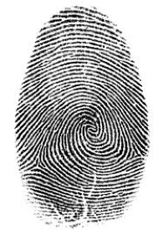
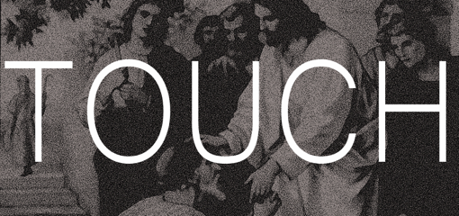
Where?
Notes:
As we move into our time of communion, celebrating the one who was sent to us and gave Himself for us. Where has God worked in your life? Where has He touched you? Give Him thanks. Thank Him for that as you celebrate His body and blood given for you.
And .. where do you need God’s touch? Where are you broken, or limited? Call on Him.
At this time, would those who are going to help serve please come to the front and take the elements to serve the congregation. We will be serving communion by intinction. In the Church of the Nazarene we celebrate and open communion. If you are a believer and walk in fellowship with God, you are welcome to join us at the table. We will make our way up either of the two aisles and then return to our seats down the outer aisles. I invite you to remain at the altar to pray whether kneeling, sitting, or standing if it would be helpful to you in reflecting about God’s work in your life or the places that you need God to touch.
On the night …

Slide 28
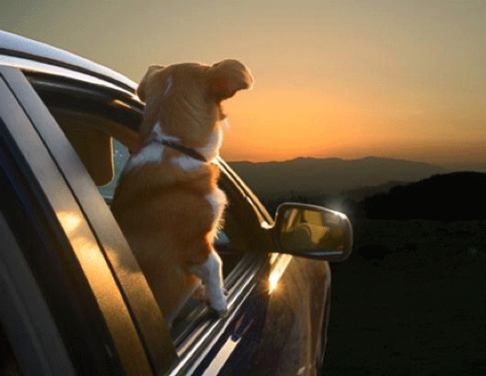
Who are we fixing our eyes on?
…. fixing our eyes on Jesus, the author and perfecter of our faith
Hebrews 1:2
Notes:
You know, Jesus wasn’t done with the man after He healed him. Jesus still saw him. Jesus still noticed what was happening. He saw that the man told about what Jesus had done. Simply. Factually. And He saw that the man was insulted, looked down on, ostracized, put out of the synagogue. But what did Jesus direct Him to do? He had the man look at Him. To fix his eyes on Jesus. I pray that we will have the ability to fix our eyes on Jesus, the author and perfecter of our faith.

