Slide 1
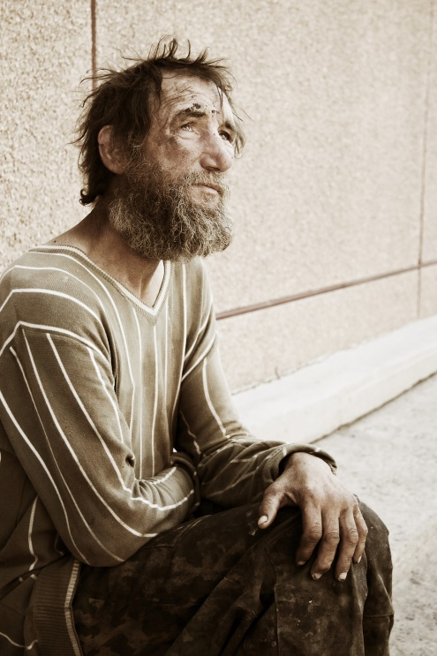
Lazarus and the Rich Man
Luke 16.19-30

Slide 2
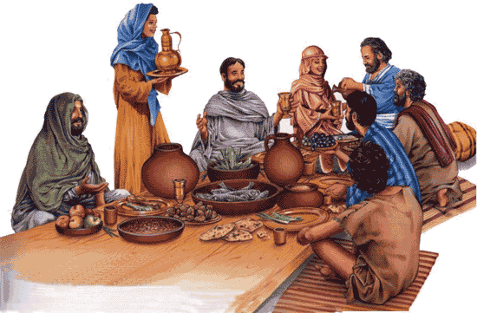
A lot of Jesus' teaching and miracles seemed to happen around tables.

Slide 3
Jesus begins by painting a picture of self-indulgence.

Slide 4
“Jesus audience, or at least a significant part of it, would have been steeped in the belief that riches were a blessing for obedience, with suffering a punishment for sin,” and thus they were “outraged” to hear that Lazarus had been received by Abraham.” Amy-Jill Levine

Slide 5
“Open you hand to the poor and needy neighbor in your land” Deut. 15:11

Slide 6
The name Lazarus translated means “God helps”… apparently God’s intervention is dependent on His followers to do what they are taught.

Slide 7
Abraham then says ‘remember.’
Recalling something which is part of its meaning in Scripture
It also carries within it an OT prophetic meaning = repent.

Slide 8
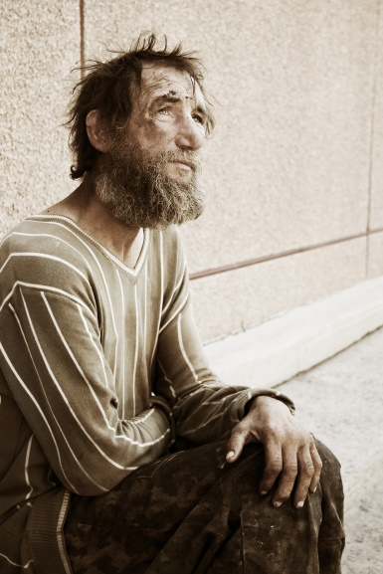
Abraham tells the rich man that they have the Law and the Prophets (OT) and that is sufficient for them to ‘hear.’
‘To hear’ in Semitic languages is to ‘listen and obey.’ (Discipleship).

Slide 9
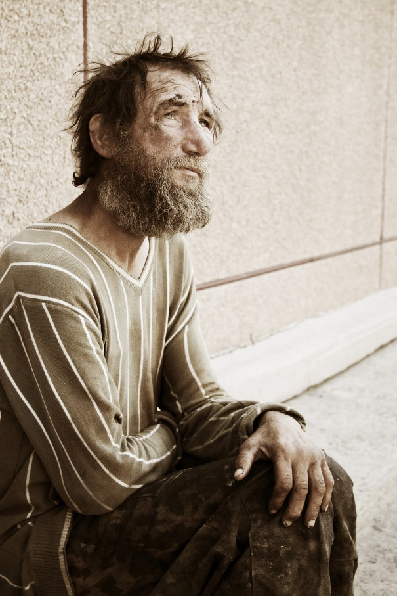
Might we imagine a different ending to this parable?

Slide 10
small requests : a crumb of food, a drop of water, a messenger to tell others who God is and what it means to live out that Kingdom by obeying God’s word.
“If anyone is thirsty, let him come to me and drink. Whoever believes in me, as the Scripture has said, streams of living water will flow from within him.”

Slide 11
is there someone sitting at your gate?

Slide 12
We are here to invite others to share in the table… the table provided for us and them…
“Great is the church where the people who are not there are more important than the people who are there.”

