Slide 1
God Is Light
John 1:6-12
Psalm 27:1

Slide 2
⁶ There was a man sent from God whose name was John. ⁷ He came as a witness to testify concerning that light, so that through him all might believe. ⁸ He himself was not the light; he came only as a witness to the light.

Slide 3
- ⁹ The true light that gives light to everyone was coming into the world. ¹⁰ He was in the world, and though the world was made through him, the world did not recognize him. ¹¹ He came to that which was his own, but his own did not receive him. ¹² Yet to all who did receive him, to those who believed in his name, he gave the right to become children of God— John 1:6-12 (NIV)

Slide 4
¹ The Lord is my light and my salvation — whom shall I fear? The Lord is the stronghold of my life — of whom shall I be afraid? Psalm 27:1 (NIV)

Slide 5
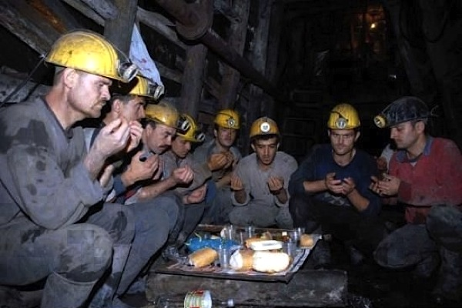
¹ The Lord is my light and my salvation — whom shall I fear? The Lord is the stronghold of my life — of whom shall I be afraid? Psalm 27:1 (NIV)

Slide 6
God is light! The true light that gives light to everyone was coming into the world. V.6

Slide 7
Light gives Life. “God said, "Let there be light…“ Genesis 1:3

Slide 8
“If I find in myself a desire that this world cannot fulfill, the most probable explanation is that I was made for another world.” CS Lewis

Slide 9
Light is a Guide. ¹ The Lord is my light and my salvation — whom shall I fear? The Lord is the stronghold of my life — of whom shall I be afraid? Psalm 27:1 (NIV) “Your word is a lamp to my feet And a light to my path.” Ps. 119:105.

Slide 10
¹ The Lord is my light and my salvation — whom shall I fear? The Lord is the stronghold of my life — of whom shall I be afraid? Psalm 27:1 (NIV)

Slide 11
¹ The Lord is my light and my salvation — whom shall I fear? The Lord is the stronghold of my life — of whom shall I be afraid? Psalm 27:1 (NIV)

Slide 12
Light is a symbol of Hope. “The people who walked in darkness have seen a great light; those who dwelt in the land of the shadow of death, upon them a light has shined.” (Is. 9:2)

Slide 13
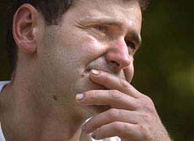
July 24-28, 2002 Randall Fogle Harry "Blaine" Mayhugh, Jr. Thomas "Tucker" Foy John Unger John Phillippi Ron Hileman Dennis J. Hall Robert Pugh, Jr. Mark Popernack

Slide 14
⁹ The true light that gives light to everyone was coming into the world. ¹⁰ He was in the world, and though the world was made through him, the world did not recognize him. ¹¹ He came to that which was his own, but his own did not receive him. ¹² Yet to all who did receive him, to those who believed in his name, he gave the right to become children of God— John 1:6-12 (NIV)

Slide 15
Jesus Christ IS the Light of the World. The Light of God, that you and I must share... The Lord is my light and my salvation — whom shall I fear? The Lord is the stronghold of my life — of whom shall I be afraid? Psalm 27:1 (NIV)

